Slide 1
Unit 1Welcome to New York
Lesson 10-11
“I believe in liberty and happiness”
For the 9th form
Гудкова Ирина Алексеевна,
учитель английского языка
МБОУ «АСОШ №2»
п.Адамовка.

Slide 2
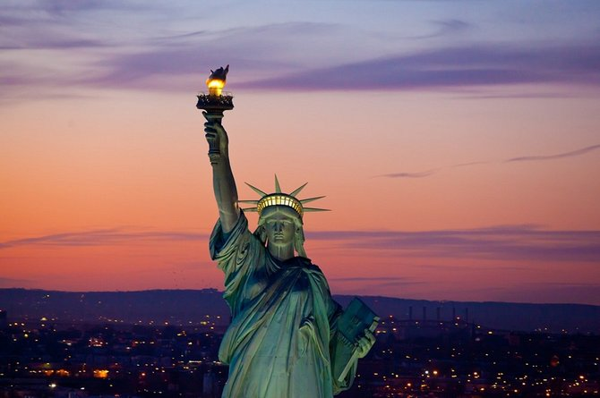
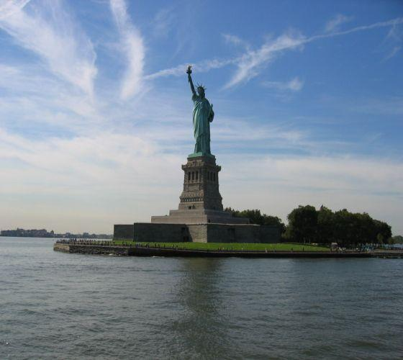
The millions of immigrants who had to come to the USA by sea were welcomed by a very tall woman. She is the Statue of Liberty.

Slide 3
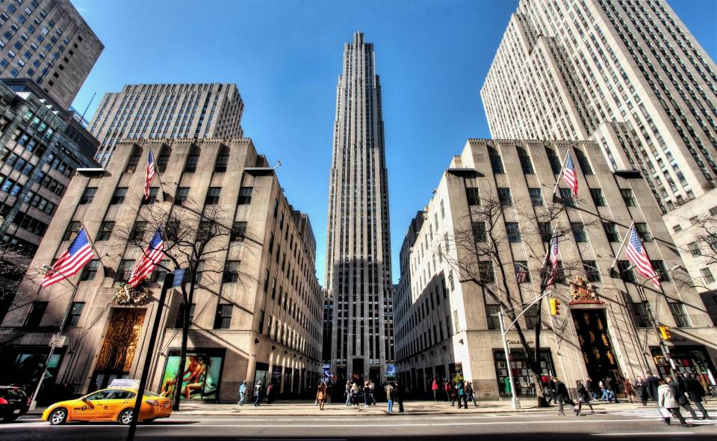
Rockfeller center

Slide 4
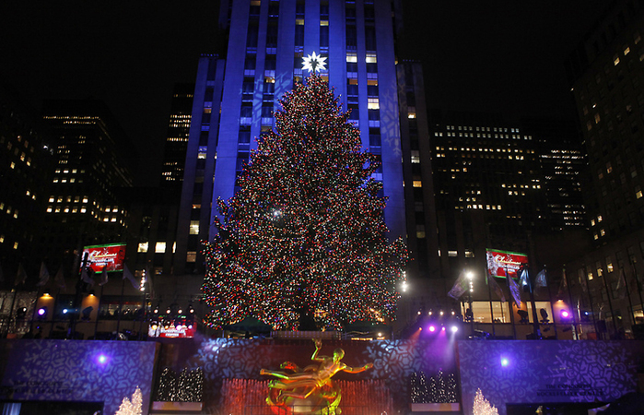
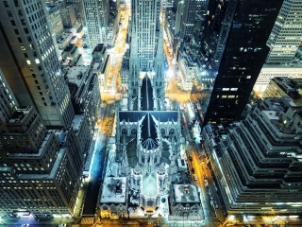
It is located in the center of Midtown Manhattan, spanning the area between Fifth Avenue and Sixth Avenue.
It was declared a National Historic Landmark in 1987.

Slide 5
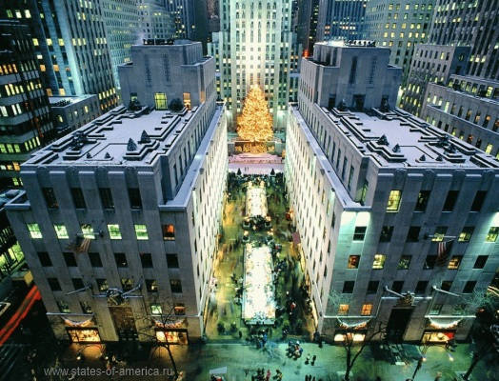
Rockefeller Center is a complex of 19 commercial buildings covering 22 acres (89,000 m²) between 48th and 51st streets
In New York City, United States

Slide 6
Listen to the words and expressions and repeat them after the speaker.
human values — человеческие ценности
worth — зд. ценность
to imply [im'plai] — подразумевать, предполагать
a duty — обязанность
a right — право
to owe — быть должным
to make a living — зарабатывать на жизнь
justice — справедливость
to endure — зд. соблюдать
a bond — обязательство
will — воля
to triumph — восторжествовать
might [mait] — сила
a possession — владение
sacredness of smth — нерушимость чего-либо
fulfilment — зд. самореализация
dignity of labor — величие труда
usefulness — польза
a responsibility — ответственность
an opportunity — возможность
an obligation — долг
fundamental — основополагающий
wealth — богатство
a servant — слуга
a master — хозяин

Slide 7
History
The Rockfeller center was constructed on money of a family Rokfeller in the 30th years of the twentieth century and includes 19 buildings on the area of 9 hectares. Here the majority of national TV programs are made and offices of the largest world corporations are located

Slide 8
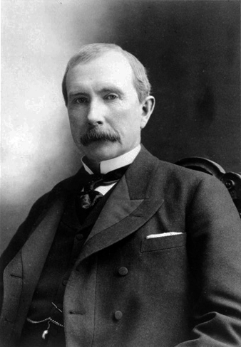
Rockefeller
John D. Rockefeller
John Devison Rockefeller was a rich arictocrat, american businessman, the philanthropist. He belived in people and their human values. John Devison Rockefeller was intelligent, hard-working and successful person.

Slide 9
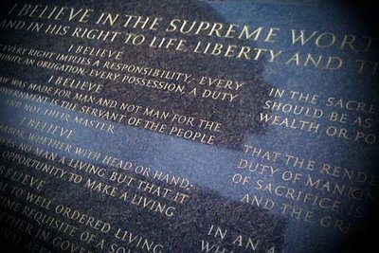
I believe that the rendering of useful service is the common duty of mankind and that only in the purifying fire of sacrifice is the dross of selfishness consumed and the greatness of the human soul set free. , (John D. Rockefeller, Jr.)

Slide 10
I believe in the supreme worth of the individual and in his right to life, liberty and happiness.
I believe that every right implies a responsibility; every opportunity – an obligation; every possession – a duty.
I believe that the law was made for man and not for the law, that the government is the servant of the people, and not their master.
I believe that truth and justice are fundamental to an enduring social order.
I believe in the dignity of labour, whether with head and hand.
I believe in the sacredness of promise, that a man’s word should be as good as bond.
I believe in all – wise and all loving God. Religion doesn’t matter, but it’s important to believe in Him.
I believe that love is the greatest thing in the world which gives men happiness, overcomes hate and evil.

Slide 11

Everyone must keep promises. This is Law for the rich and the poor. Human values are not wealth and power, but kind character and intelligence .

Slide 12
Match Rockefeller’s words with the following ideas:
1. I believe in the supreme worth of the individual and in his right to life, liberty, and happiness.
2. I believe that the law was made for man and not man for the law, that government is the servant of the people and not their master.
3. I Believe in an all-wise and all-loving God, named by whatever name. The individual’s highest fulfillment, greatest happiness, are found in living in harmony with his will.
4. I believe that love is the greatest thing in the world, that it alone can overcome hate, that right can and will triumph over might.
A: Presidents and ministers must work for the people.
B: Everybody has the right to be happy.
C: Love is the most powerful thing in the world.
D: Your religion doesn’t matter; but it’s important to believe in God.

Slide 13
Oтвлеченные существительные от прилагательных образуются при помощи следующих суффиксов:
-ness – sleepiness (sleep — спать) — сонливость , loneliness (lonely — одинокий) – одиночество, darkness (dark — темный ) — темнота, politeness (polite — вежливый) — вежливость
-ment — movement (move — двигать) — движение , announcement (announce — объявлять) – объявление, agreement (agree — соглашаться) — согласие
-dom – freedom (free — свободный) — свобода, boredom (bore — скучный) — скука, kingdom (king — король) — королевство
-ion/ -tion / -sion / -ssion – competition (compete — соревноваться) — соревнование, admission (admit — признавать) — признание, celebration (celebrate — праздновать) — празднование, revision (revise — пересматривать) — пересмотр
-ure / -ture — adventure — приключение, agriculture – сельское хозяйство, nature — природа
— hood – childhood (child — ребенок) – детство, brotherhood (brother — брат) – братство, neighbourhood (neighbour — сосед) соседство
-ship – partnership (partner- партнер) партнерство, ownership (owner — собственник) — собственность, hardship (hard — трудный) — трудность
— ist — idealist (ideal — идеал) — идеалист, artist (art — искусство) pianist (piano- пианино) — пианист
-ance/-ence – importance (important — важный) — важность, disappearance (disappear — исчезать)- исчезновение, presence (present- присутствовать) – присутствие, silence (silent — безмолвный) — молчание

Slide 14
Make up as many words as you can
-ness, -ship, -dom, -hood, less
happy weak
free king
child brother
friend member
wise mother
dictator useful
star kind
home job

Slide 15
Homework
Ex. A. p.13. (W.B.) Translate Rockefeller's words into Russian.

Slide 16
Литература:
К.И. Кауфман, М.Ю. Кауфман Английский язык: Счастливый английский.ру/ Happy English.ru: Учебник англ. яз. для 9 кл. общеобраз. учрежд. - Обнинск: Титул, 2008
Тобольская С.И. English-speaking countries. Страноведческий справочник: Учебное пособие. – Саратов: Лицей, 2004. – 176 с.
http://terekhofff.at.ua/photo/nju_jork_foto
http://eamerica.ru/foto/new-york-2.php
http://all-new-york.ru/new-york/dostoprimechtelnosti
http://terekhofff.at.ua/photo/nju_jork_foto
http://eamerica.ru/foto/new-york-2.php
http://all-new-york.ru/new-york/dostoprimechtelnosti
https://infourok.ru/pamyatka-abstraktnie-suschestvitelnie-v-angliyskom-yazike-klassi-1166127.htm
http://grammar-tei.com/abstraktnye-sushhestvitelnye-v-anglijskom-yazyke-obrazovanie-abstraktnyx-sushhestvitelnyx/

